Slide 1

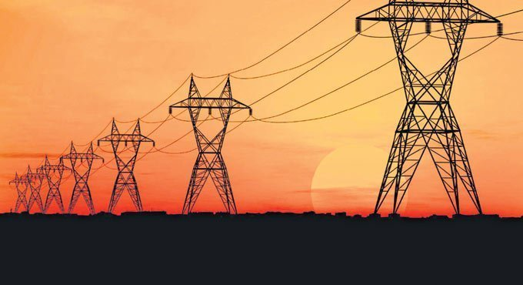
POWER THEFT DETECTION IN SMART GRIDS BASED ON CNN
NATIONAL INSTITUTE OF TECHNOLOGY PUDUCHERRY
Karaikal-609609
PROJECT PHASE 2: FINAL REVIEW
25-03-2022
Submitted By:
1. D.Karthiga [EE18B1014]
2. M.Gopikasri[EE18B1019]
3. Prasanna Bhagyasree[EE18B1039]
Under the Guidance of:
Dr.Thangavel
Department of Electrical and Electronics Engineering

Slide 2
CONTENTS
MOTIVATION OF PROJECT
OBJECTIVES
INTRODUCTION
LITERATURE SURVEY
METHODOLOGY
RESULTS AND DISCUSSION
REFERENCES
CONCLUSION

Slide 3
MOTIVATION OF PROJECT
Conventional electricity-theft detection methods include humanly checking problematic meter installation or misconfiguration, comparing the abnormal meter readings with the normal ones and examining the bypassed power transmission line, etc, but these methods are extremely time-consuming, expensive, and inefficient.
In addition, some recent works show that data analysis on smart grids can help detect electricity theft.
Most of them are based on artificial feature extraction according to domain knowledge and hence require manual interventions. Many methods such as support vector machines and linear regression have low electricity-theft detection accuracy.
Power theft in a country hits its GDP hard. So it is very important to prevent power theft for undisturbed supply of good quality power everywhere.

Slide 4
OBJECTIVES
To study, analyze machine learning models for power theft detection using CNN and compare their results to find the best model which gives higher accuracy.
To detect and identify the power theft in Smart grids.
To include an Exploratory data analysis by the Deep CNN component can accurately identify the non-periodicity of electricity-theft and the periodicity of normal electricity usage based on two dimensional (2-D) electricity consumption data

Slide 5
INTRODUCTION
Electricity theft is harmful to power grid suppliers and causes economic losses.
The smart grid (SG) infrastructure generates a massive amount of data, including the power consumption of individual users.
Utilizing this data, machine learning, and deep learning techniques can accurately identify electricity theft users. A convolutional neural network (CNN) model for automatic electricity theft detection is presented.
Till now methods have been used to find the theft detection in 1-D electricity consumption data. These methods have a limitation that they have poor detection accuracy of the illegal user and failed to capture the periodicity of electricity consumption.
So the proposed system overcomes this limitation by the Deep CNN component can accurately identify the non-periodicity of electricity-theft and the periodicity of normal electricity usage based on two-dimensional (2-D) electricity consumption data.

Slide 6
LITERATURE SURVEY
TITLE OF THE PROJECT | FEATURES | LIMITATIONS
Noor Mahmoud Ibrahim, Sufyan T. Faraj Al-Janabi, Belal Al-Khateeb. “Electricity-theft detection in smart grids based on deep learning.” Bulletin of Electrical Engineering and Informatics Vol. 10, No. 4, August 2021. | This work is intended to identify electricity theft from the power consumption pattern of users, utilizing CNN-based deep learning and BM techniques. the dataset has been reduced before building the models to increase the performance of building models and classifying new electricity signals. . | They have not proposed any solution to locate the dishonest users.
D. Alahakoon, X. Yu, “Smart Electricity Meter Data Intelligence for Future Energy Systems: A Survey,” in IEEE Transactions on Industrial Informatics, vol. 12, no. 1, pp. 425-436, Feb. 2016 | Comprehensive survey of smart electricity meters and their utilization focusing on key aspects of the metering process, and the technologies used to satisfy stakeholder interests.. the paper highlights challenges as well as opportunities arising due to the advent of big data and popularity of cloud environments. | cloud-based smart metering solution, targeted at small utilities and communities that previously could not afford such technologies.

Slide 7
Literature survey
TITLE | PROCEDURE FOLLOWED | RESULTS | CONCLUSION
“Power Monitoring and Theft Detection System using IoT “ R.Meenal1Department of Electrical and Electronics Engineering Karunya Institute of Technoloe gy and Sciences Coimbatore-641114(2019) | In this system IoT and GSM technology is implemented for transmitting the information about power theft to utility. This system is being interfaced with Raspberry pi and Arduino via serial communication are interfaced with raspberry pi to sense the load current and voltage.. | Voltage and current value in IOT webpage. Real time monitoring of the loads is possible and location of theft is determined | Power theft is actually bypassing the energy meter but in this project the theft is indicated by increasing the load also and this method is cost efficient
“AN EFFICIENT ELECTRICITY THEFT AND FAULT DETECTION SCHEME IN DISTRIBUTION SYSTEM” Muhammad Salik, Muhammad Fahad Zia, Fahad Ali School of Science and Teces hnology | At every instant, readings of the customer smart meters are added and compared with the reading of the observer meter of the associated transformer. If the observer meter current is more than 5% of collective current of smart meters. | If the difference between the readings is more than 5%, then the proposed algorithm diagnoses the theft or fault case. The results have shown that the system is completely reliable, efficient and it is able to discriminate between theft and fault scenarios. | The proposed system definitely decreases electricity theft when applied to the system because every transformer is provided with an observer meter that would show the associated area of theft

Slide 8
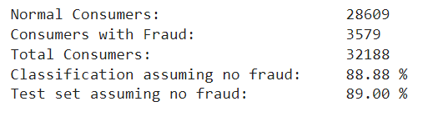
METHODOLOGY
DATASET[INPUT]
TRAINING AND CLASSIFICATION
MODEL EVALUATION
PERFORMANCE METRICS
Using performance metrics the best model which provides the maximum accuracy will be chosen.
The ML models used in this work for training are Utilizing CNN-based deep learning. And also compared using Logistic Regression, Decision Tree , Random Forest , Support Vector Machine (SVM).
Models are built and the pre-processed data is fed
Data Pre processing techniques is applied on data set to produce data for Model
Realistic dataset released by State Grid Corporation of China .
PREPROCESSING
Total dataset has 32,188 consumers.
Data is split into the training set and test set, with 80% and 20% of the dataset respectively.
SOFTWARE USED:
Python
Jupyter
NumPy
Pandas
Scikit-learn

Slide 9
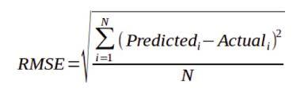
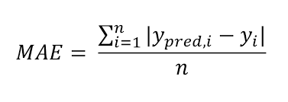

RMSE:
Root mean square error or root mean square deviation is one of the most commonly used measures for evaluating the quality of predictions.
MAE:
Mean absolute error is a measure of errors between paired observations expressing the same phenomenon.
F1 SCORE:
F-score or F-measure is a measure of a test's accuracy.
Performance metrics

Slide 10
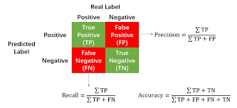
AUC:
The area under (a ROC) curve is a measure of the accuracy of a quantitative diagnostic test.
Confusion matrix:
A table that is often used to describe the performance of a classification model (or "classifier") on a set of test data for which the true values are known.

Slide 11
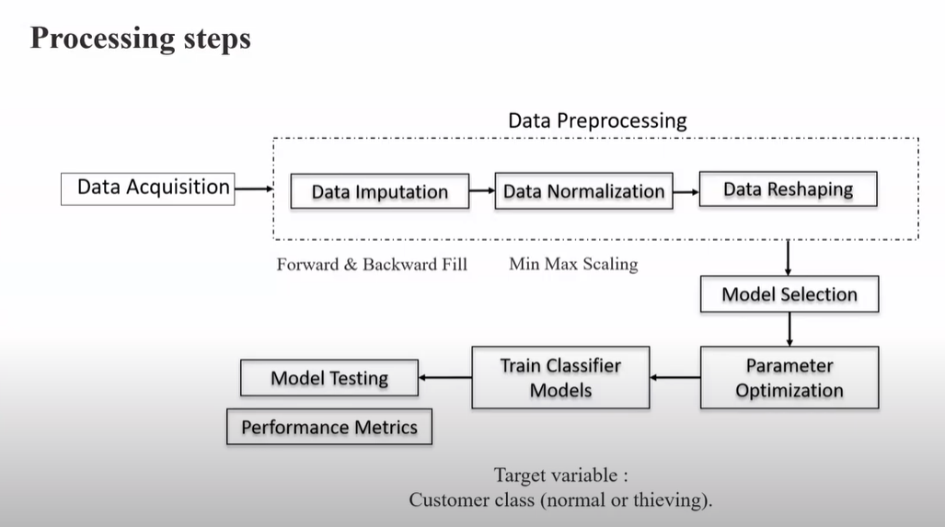

Slide 12
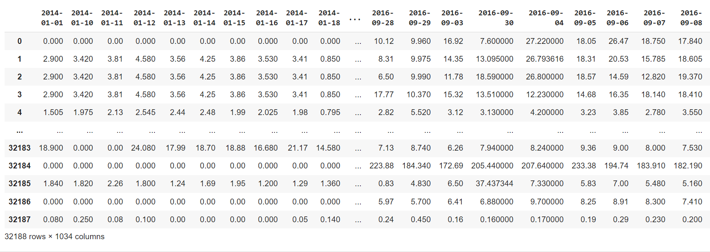
Results & Discussion
The dataset’s preview is shown

Slide 13
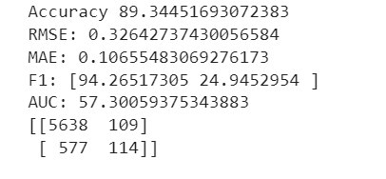
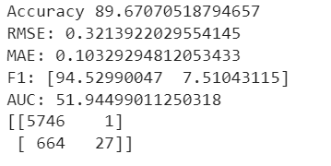
Performance Comparison
Logistic Regression :
Random Forest (RF):
Random forest model is essentially an integration of multiple decision trees. Compared with a single decision tree, random forest model can achieve better performance while maintaining the effective control of over-fitting.
This method is a basic model in binary classification, which is equivalent to one layer of neural network with sigmoid activation function.
Logistic regression
raRandom Forest

Slide 14

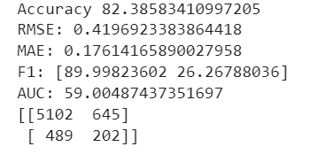
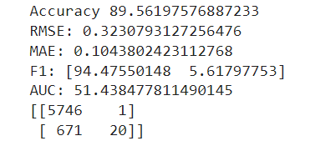
Decision Tree :
Support Vector Machine (SVM):
Decision tree builds classification models in the form of a tree structure. It breaks down a dataset into smaller and smaller subsets, called the bootstrap dataset.
The goal of a support vector machine is to find the optimal separating hyperplane which data maximizes the margin of the training .
Decision Tree
Support Vector Machine

Slide 15
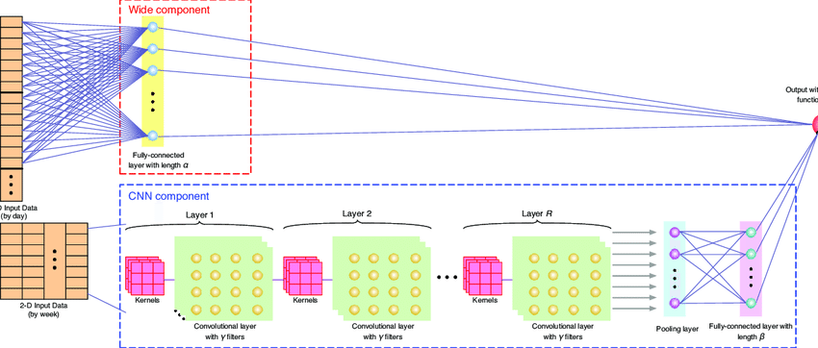
Wide & Deep Convolutional Neural Networks (CNN) framework

Slide 16
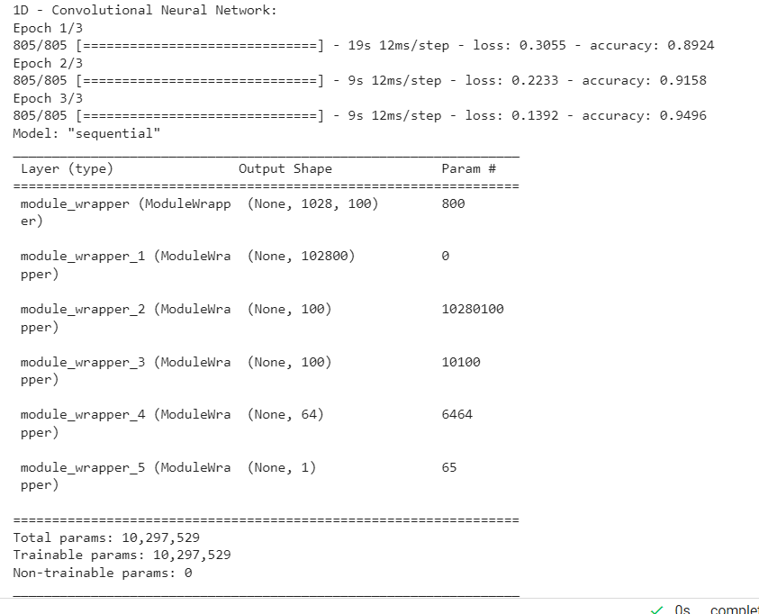
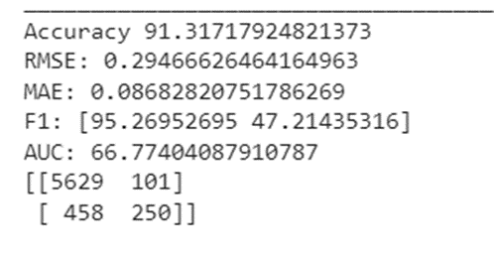
WIDE CNN
The accuracy was found to be 91.31% and AUC was 66.77.

Slide 17
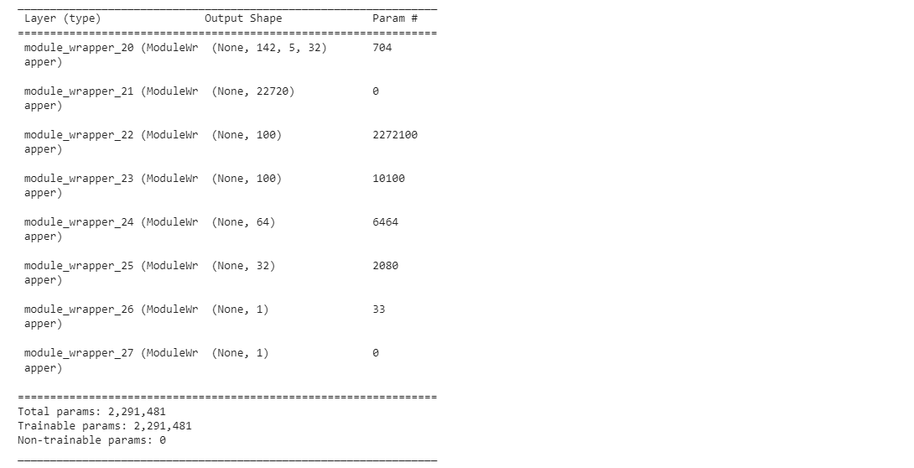
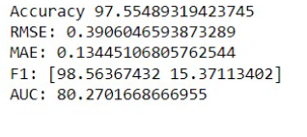
DEEP CNN
2D- CONVOLUTION NEURAL NETWORK:
The accuracy was found to be 97.55% and AUC was 80.27

Slide 18
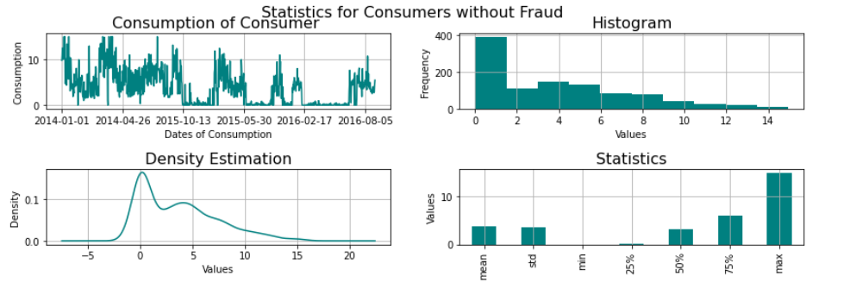
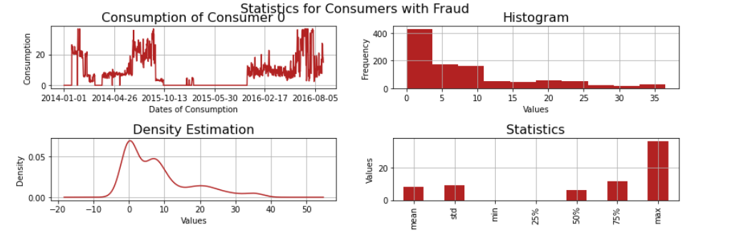

Slide 19
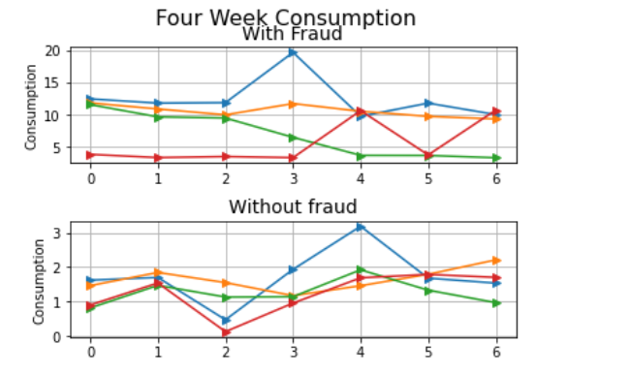
2-D VISUALIZATION PLOTS
We can observe that there is a periodicity on the electricity consumption of this customer if we plot the data in 2-D manner by week

Slide 20
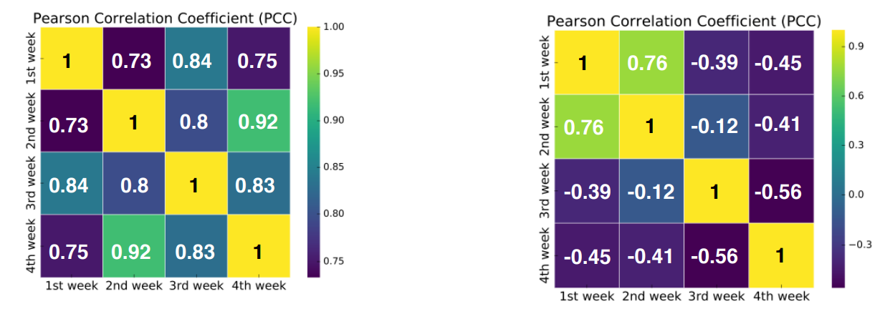
PEARSON CORRELATION COEFFICIENT
The Pearson correlation measures the strength of the linear relationship between two variables.
PCC values of normal customers
PCC values of energy thieves

Slide 21
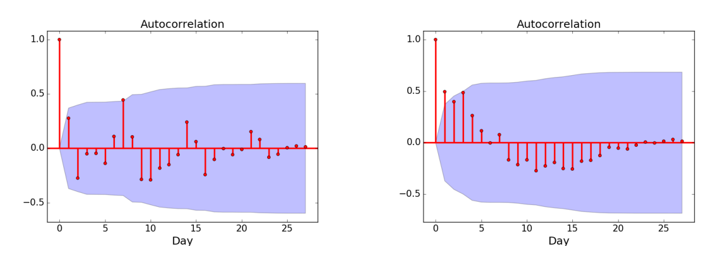
Autocorrelation function (ACF) of electricity consumption by week
ACF of the electricity consumption patterns of normal customers have obvious periodicity the similar pattern longs for about 7 days while there is no obvious periodicity of electricity consumption of energy thieves.
ACF values of normal customers
ACF values of energy thieves

Slide 22
Conclusion
The results have shown that the model reveal the periodicity of the normal electricity usage and the non-periodicity of the electricity theft.
We transform the 1-D electricity consumption data into 2-D data according to weeks.
However, we have found that the weekly transformation in practice has the best performance compared with other types of transformations.
Our preliminary results also imply that we can easily identify the abnormal electricity usage if we analyze the electricity consumption by aligning the consumption data of several weeks together.

Slide 23
REFERENCES
Zibin Zheng, Senior Member, IEEE, Yatao Yang, Xiangdong Niu, Hong-Ning Dai, Senior Member, IEEE, YurenZhou “Wide & Deep Convolutional Neural Networks for Electricity-Theft Detection to Secure Smart Grids”, Bulletin of Electrical Engineering and Informatics Vol. 10, No. 4, August 2021.
NADEEM JAVAID , (Senior Member, IEEE), HIRA GUL1 , SOBIA BAIG , (Senior Member, IEEE), FAISAL SHEHZAD , CHENGJUN XIA , (Senior Member, IEEE), LIN GUAN , (Member, IEEE), AND TANZEELA SULTANA “Using GANCNN and ERNET for Detection of Non Technical Losses to Secure Smart Grids”. Date of publication June 25, 2021.
Muhammad Salman Saeed , Mohd Wazir Mustafa , Nawaf N. Hamadneh , Nawa A. Alshammari , Usman Ullah Sheikh , Touqeer Ahmed Jumani , Saifulnizam Bin Abd Khalid and Ilyas Khan ,”Detection of Non-Technical Losses in Power Utilities—A Comprehensive Systematic Review”. Published: 11 September 2020.

Slide 24

THANK YOU!

